Slide 1
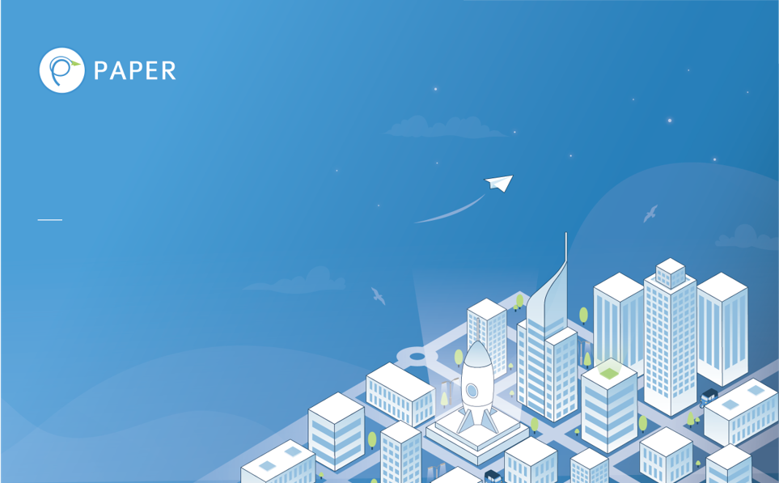

Build simple gRPC In Golang
Jafar Rohmadi

Slide 2

What is gRPC

Slide 3

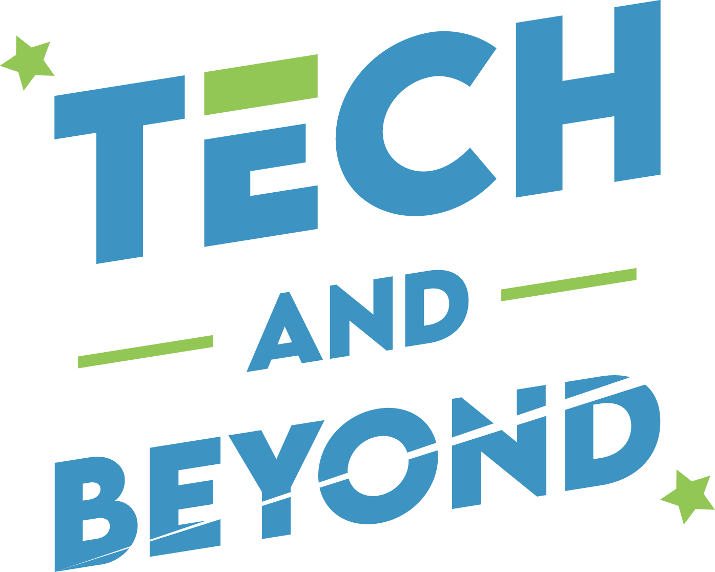
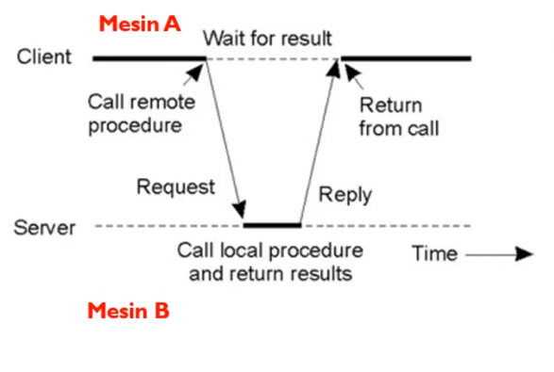
What is gRPC
gRPC is an open source remote procedure call (RPC) framework created by google in 2016. it was a rewrite of their internal RPC infrastructure that they used for years.

Slide 4
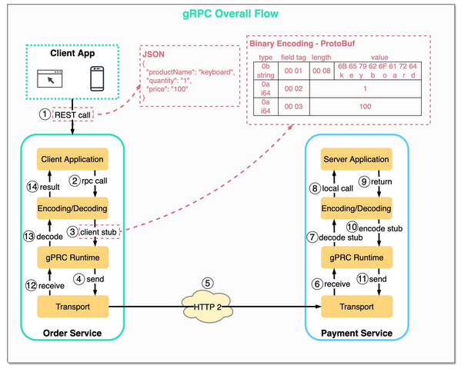
gRPC Flow

Slide 5
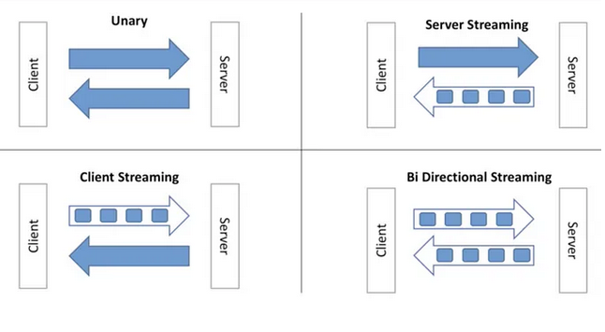
4 Type of API in gRPC

Slide 6
Why gRPC?

Slide 7
Why gRPC?
Language agnostic
High performance
Strong api contract
Automatic code generation
Notes:
Higher Code Quality: TDD encourages developers to write clean, modular, and well-structured code. By starting with tests that define the expected behavior of a feature, developers are compelled to think through the design and functionality, resulting in code that is less error-prone and easier to maintain.
Early Bug Detection: TDD ensures that bugs are caught early in the development process. When tests are written before the code, any deviations from the expected behavior are immediately identified. This means issues can be addressed when they are less costly and time-consuming to fix.
Improved Collaboration: TDD fosters collaboration among team members, including developers, testers, and product owners. It provides a common language and understanding of requirements, leading to better communication and alignment within the team.
Rapid Feedback: TDD provides rapid feedback on code changes. Developers can quickly verify that their code works as intended by running the test suite. This immediate feedback loop accelerates development and reduces the risk of introducing defects.
Enhanced Maintainability: Code developed using TDD is typically more maintainable. As changes or enhancements are needed, the existing test suite acts as a safety net, ensuring that modifications do not inadvertently break existing functionality.
Adaptability to Change: In agile methodologies, requirements often change. TDD makes it easier to adapt to changing requirements because you can update the tests to reflect the new specifications, providing confidence that existing functionality remains intact.
Documentation: The tests themselves serve as documentation for the code. They

Slide 8



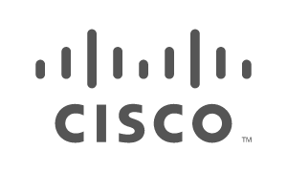


Companies Using gRPC

Slide 9
Protobuf

Slide 10
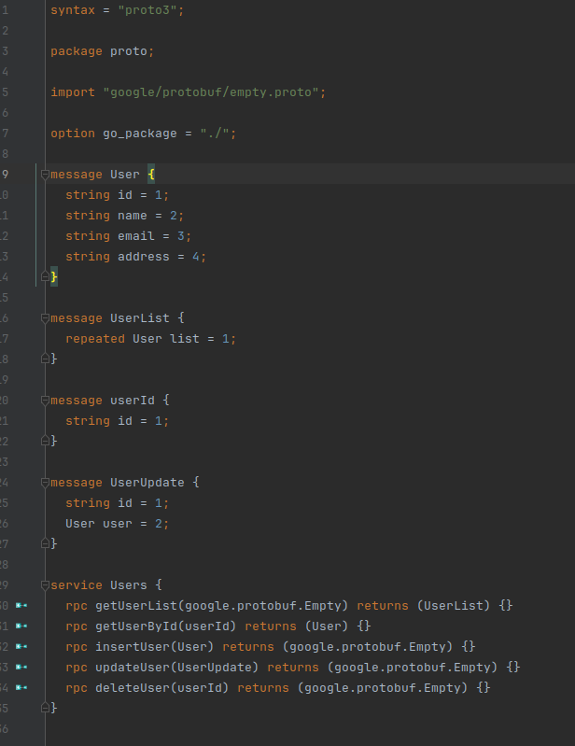
Why Protobuff
Easy to write message definition
Definition of API is independent from implementation
Code can generated in any language
Notes:
Higher Code Quality: TDD encourages developers to write clean, modular, and well-structured code. By starting with tests that define the expected behavior of a feature, developers are compelled to think through the design and functionality, resulting in code that is less error-prone and easier to maintain.
Early Bug Detection: TDD ensures that bugs are caught early in the development process. When tests are written before the code, any deviations from the expected behavior are immediately identified. This means issues can be addressed when they are less costly and time-consuming to fix.
Improved Collaboration: TDD fosters collaboration among team members, including developers, testers, and product owners. It provides a common language and understanding of requirements, leading to better communication and alignment within the team.
Rapid Feedback: TDD provides rapid feedback on code changes. Developers can quickly verify that their code works as intended by running the test suite. This immediate feedback loop accelerates development and reduces the risk of introducing defects.
Enhanced Maintainability: Code developed using TDD is typically more maintainable. As changes or enhancements are needed, the existing test suite acts as a safety net, ensuring that modifications do not inadvertently break existing functionality.
Adaptability to Change: In agile methodologies, requirements often change. TDD makes it easier to adapt to changing requirements because you can update the tests to reflect the new specifications, providing confidence that existing functionality remains intact.
Documentation: The tests themselves serve as documentation for the code. They

Slide 11
Practices

Slide 12
Example Case
Create Crud for user table with field:
Id
Name
Email
Address

Slide 13
Install tools that use for this demo
- Mysql (https://www.mysql.com/downloads/)
- golang (https://go.dev/dl/)
- gorm (https://gorm.io)
- gin (https://gin-gonic.com/)
- protoc (https://github.com/golang/protobuf)

Slide 14
Conclusion

Slide 15
Conclusion
- gRPC is a good choice for implementing microservices architectures. Microservices are small, independent services that communicate with each other over RPC.
- gRPC is a good choice for real-time applications because it is high-performance. This makes it well-suited for applications such as chat, gaming, and streaming media.
Notes:
In conclusion, Test-Driven Development is not just a practice; it's a mindset that promotes writing clean, maintainable, and robust code. By starting with well-defined tests, we ensure that our software meets the desired specifications from the outset. This approach significantly reduces defects, enhances collaboration, and ultimately leads to more reliable and adaptable software solutions.

Slide 16

Thanks! Let Connect https://www.linkedin.com/in/jafar-rohmadi-660103144/

Slide 17
Credit
bytebytego.com
Grpc.io

